Slide 1
Mesosphere DC/OS
Alex Fernandes – Sales Engineer

Slide 2
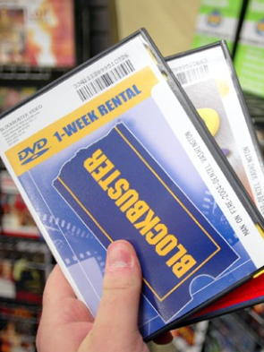
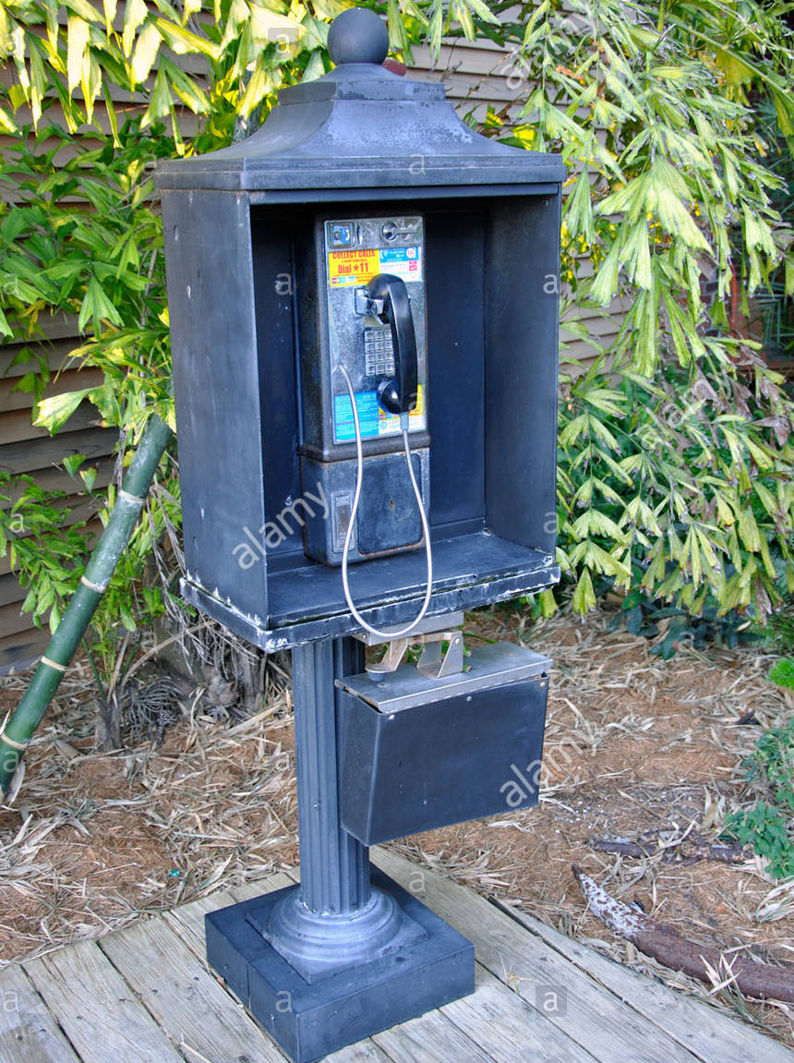
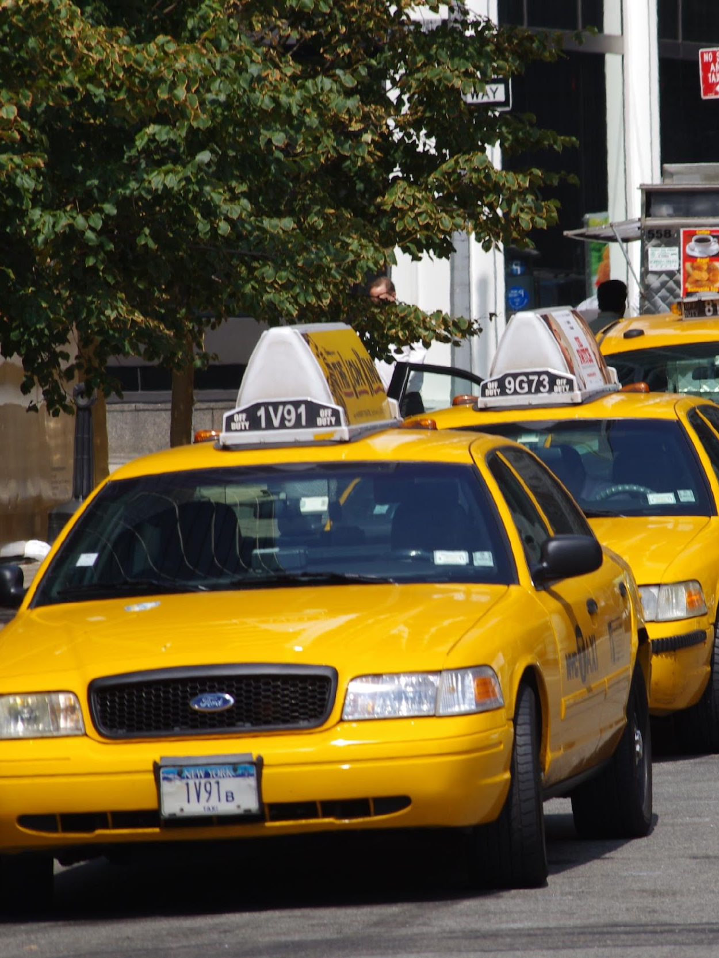

Slide 3
The time to adapt to disruptions is shrinking
The companies on the original S&P stayed there for an average of 65 years. By 1998, the average anticipated tenure of a company on the expanded S&P 500 was 10 years.
65 years
10 years

Slide 4
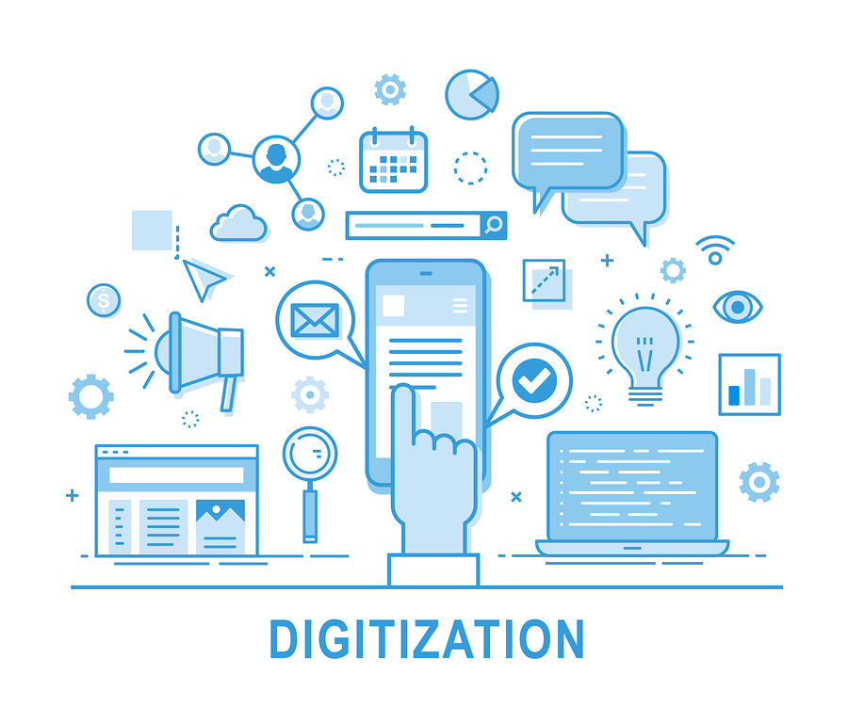

Slide 5
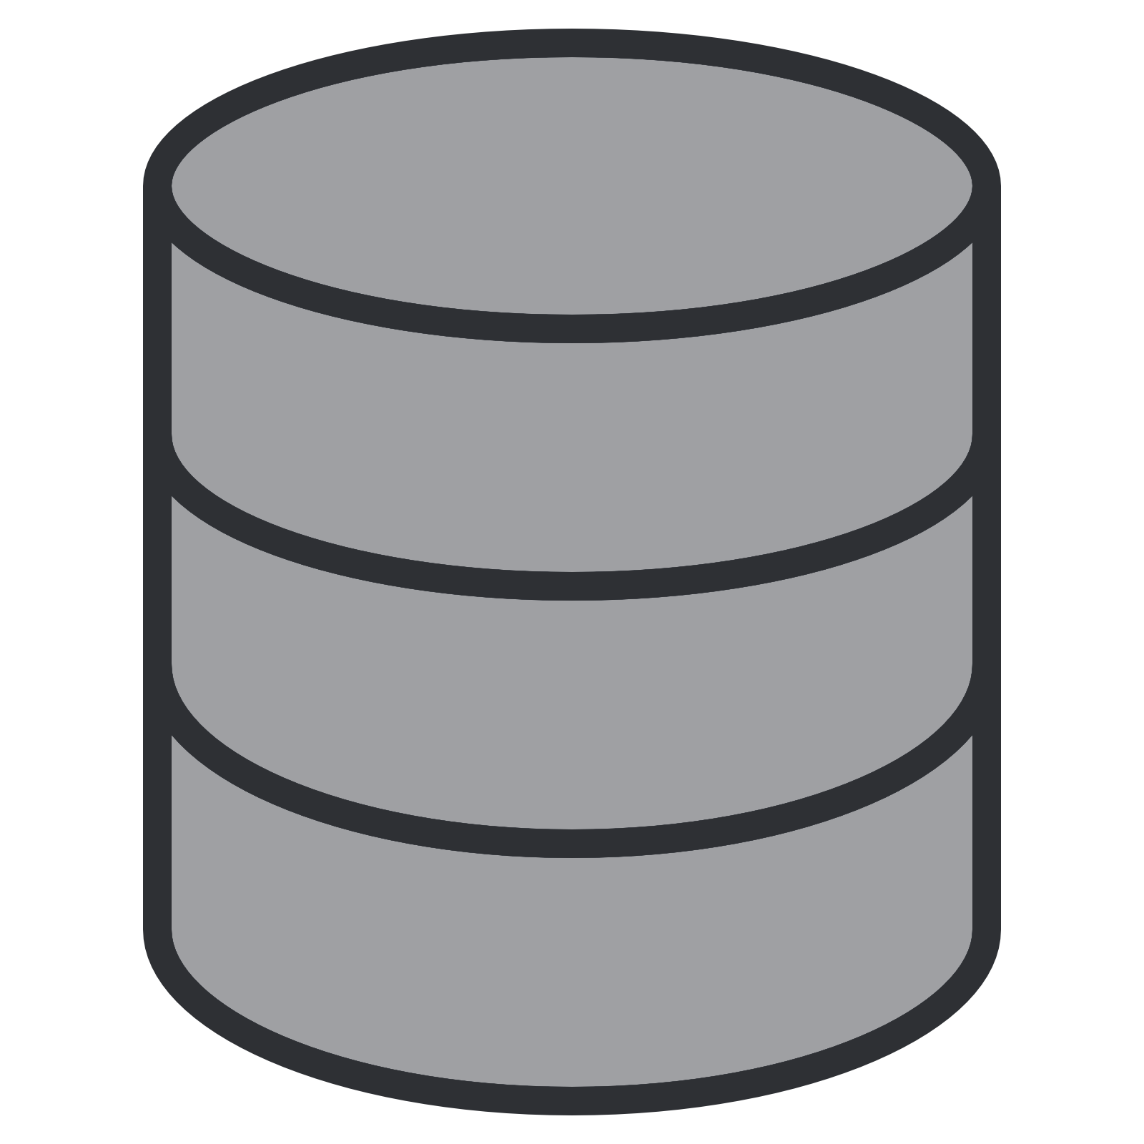
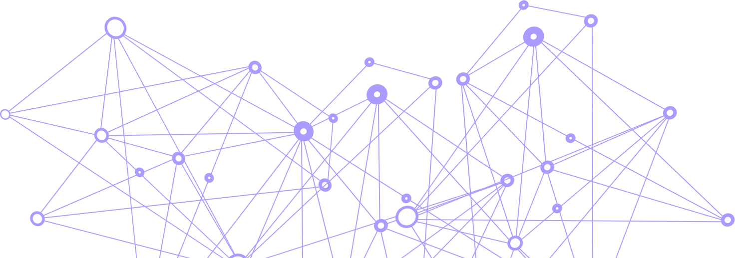

Reality of Changing IT Landscape
18 Billion connected users & devices
Users (Employees)
Always-connected customers & devices
TRADITIONAL APPLICATION
MODERN DATA-DRIVEN APPLICATION
Monolith
Containerized microservices (your code)
Serve
Relational DB
Data services & AI/ML tools
(their code)
DC or Cloud
Hybrid Cloud & Edge
Transport
Store
Analyze / Streaming
Analyze
Analyze / ML
Source: 2017 IHS Markit estimates

Slide 6

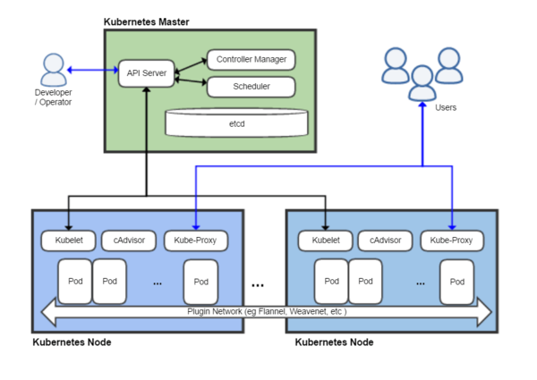
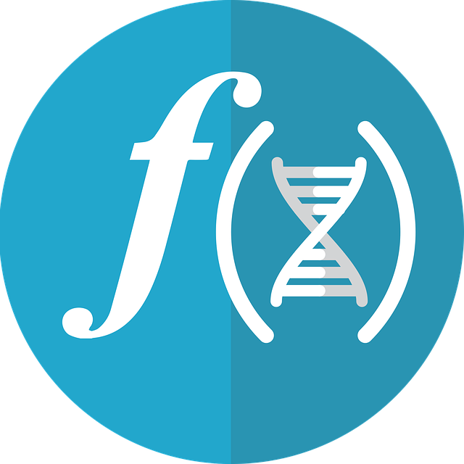


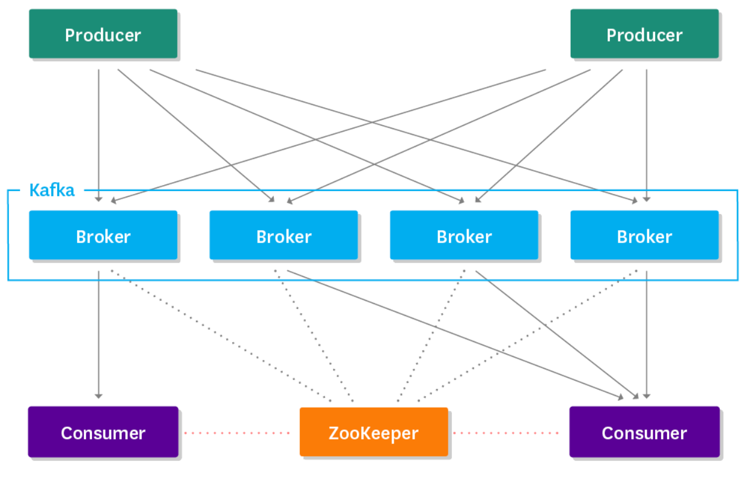
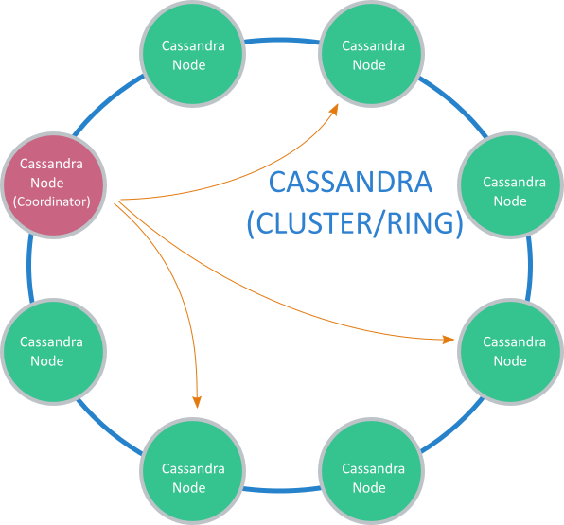
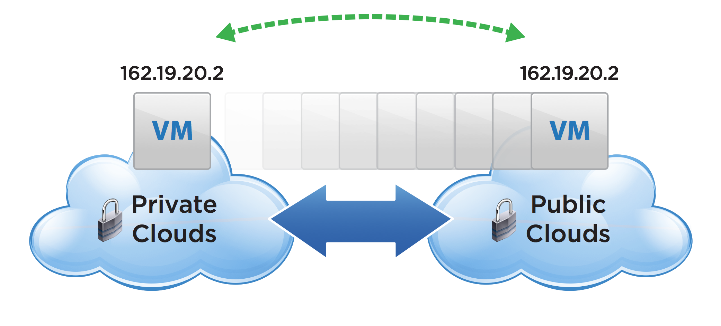
What this Means for Enterprise IT
EXISTING APPLICATIONS
NEW APPLICATIONS
Analyze
Serve
Apache Spark analytics engine
Kubernetes container orchestrator
PRESENTATION
+
BUSINESS LOGIC
DATABASE
Transport
Store
Apache Kafka message queue
Apache Cassandra distributed DB

Slide 7

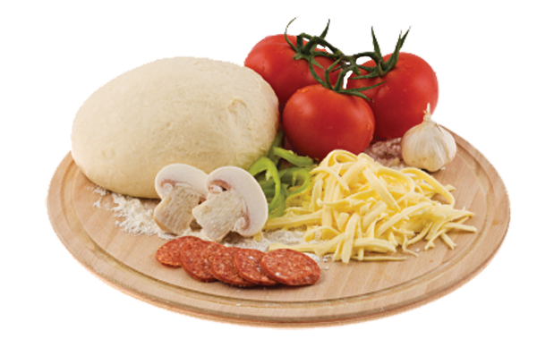
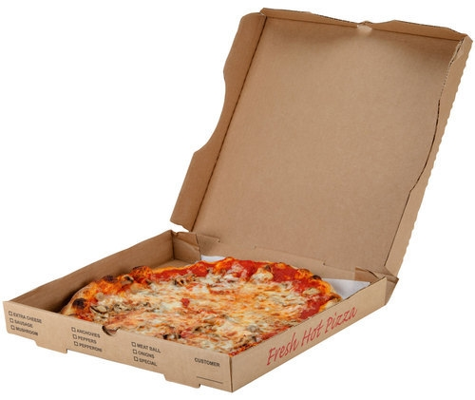

Slide 8
“Provide public cloud-like services from an open partner ecosystem, delivered on any infrastructure.”

Slide 9

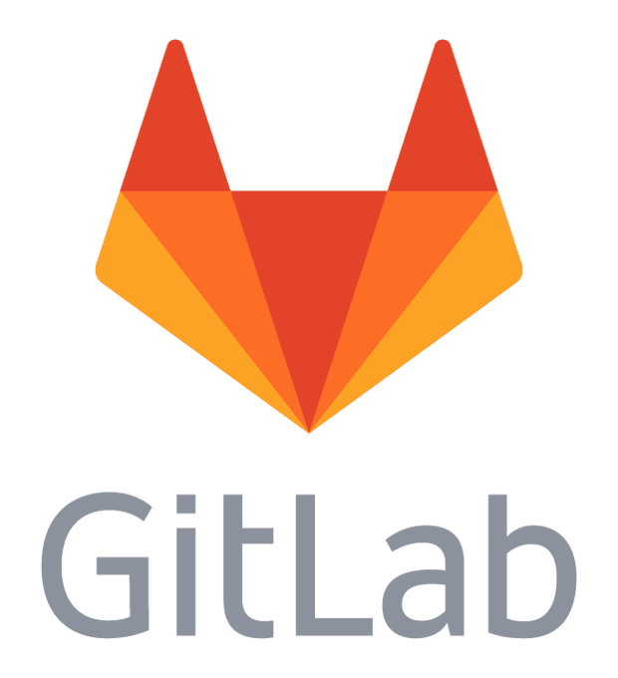
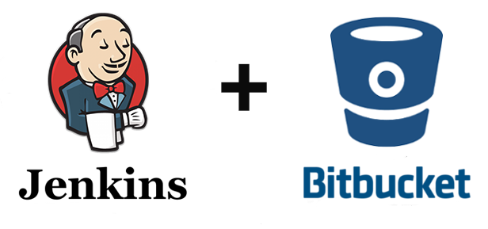

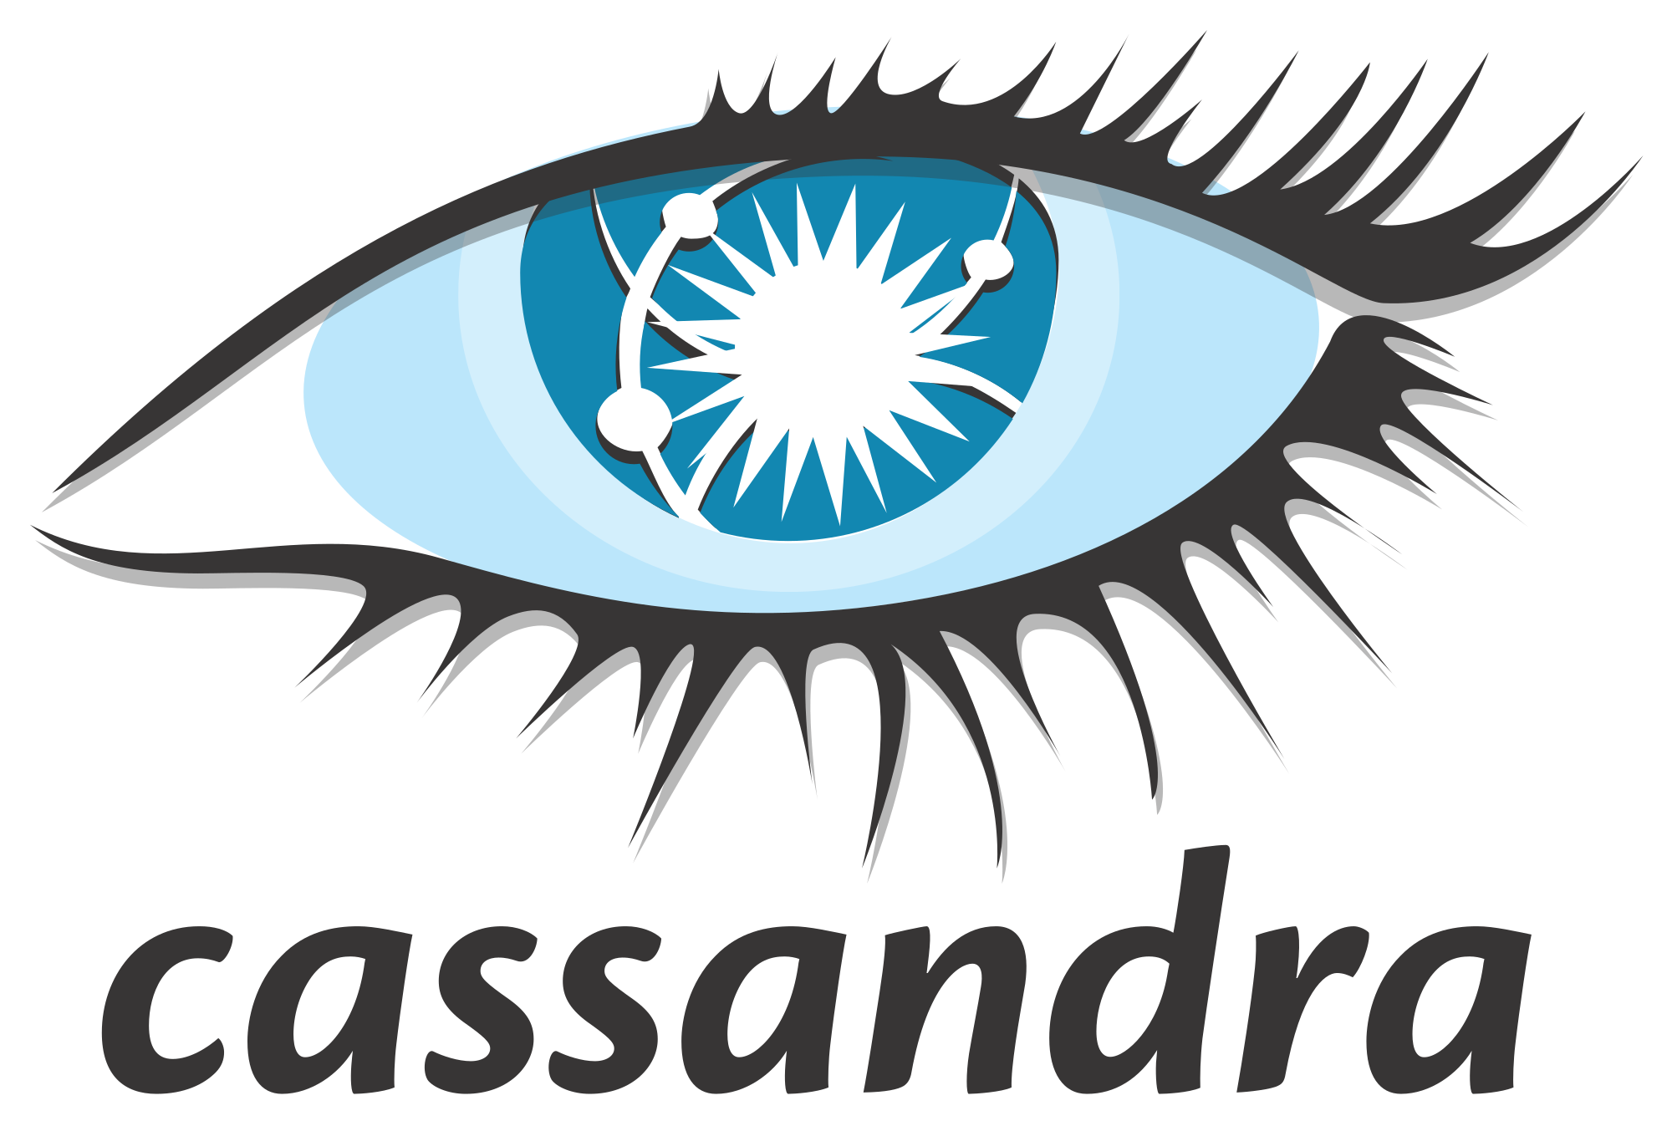
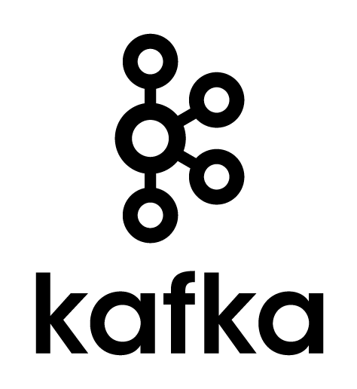

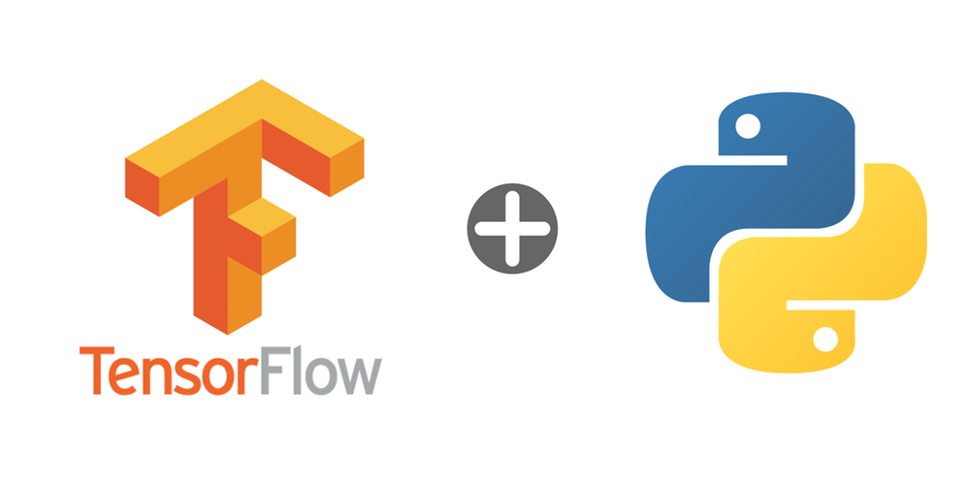
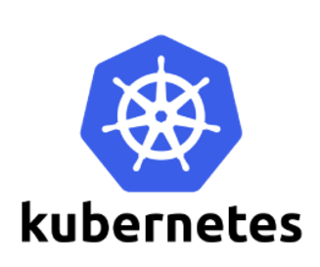
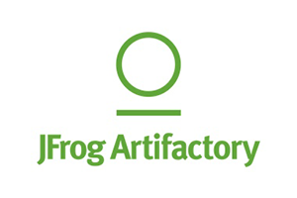
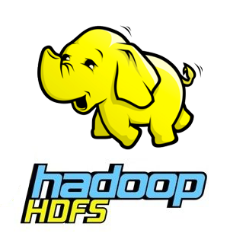
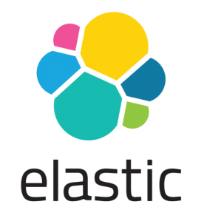




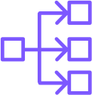

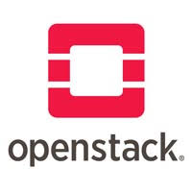
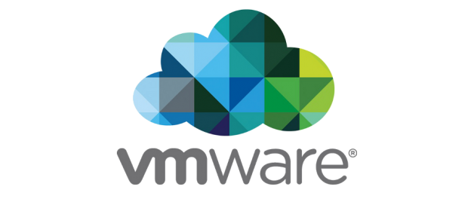
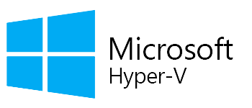
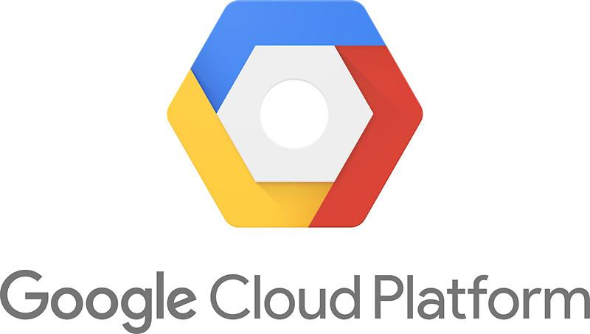

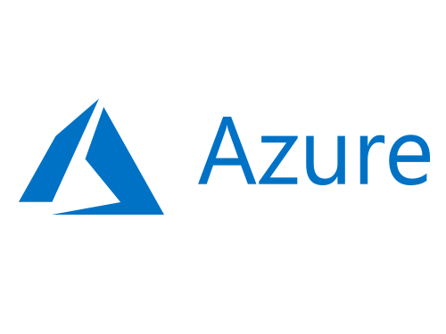
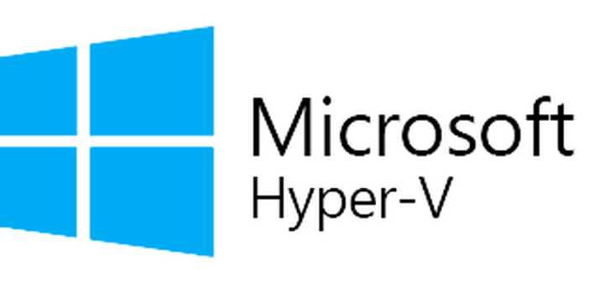
Mesosphere DC/OS enables digital transformation
MICROSERVICES, CONTAINERS, & DEV TOOLS
DATA SERVICES, MACHINE LEARNING, & AI
20+ MORE
100+ MORE
Application-Aware Automation
Security & Compliance
Hybrid Cloud Management
Multitenancy
Datacenter and Cloud as a Single Computing Resource Powered by Apache Mesos
PHYSICAL INFRASTRUCTURE
VIRTUAL MACHINES
PUBLIC CLOUDS
Edge
Datacenter

Slide 10
Mesosphere DC/OS enables digital transformation
MICROSERVICES, CONTAINERS, & DEV TOOLS
DATA SERVICES, MACHINE LEARNING, & AI
1
Broad workload coverage
Run today & tomorrow’s applications including traditional J2EE, containers, analytics & ML
20+ MORE
100+ MORE
Application-Aware Automation
Security & Compliance
Hybrid Cloud Management
Multitenancy
Datacenter and Cloud as a Single Computing Resource Powered by Apache Mesos
PHYSICAL INFRASTRUCTURE
VIRTUAL MACHINES
PUBLIC CLOUDS
Edge
Datacenter

Slide 11
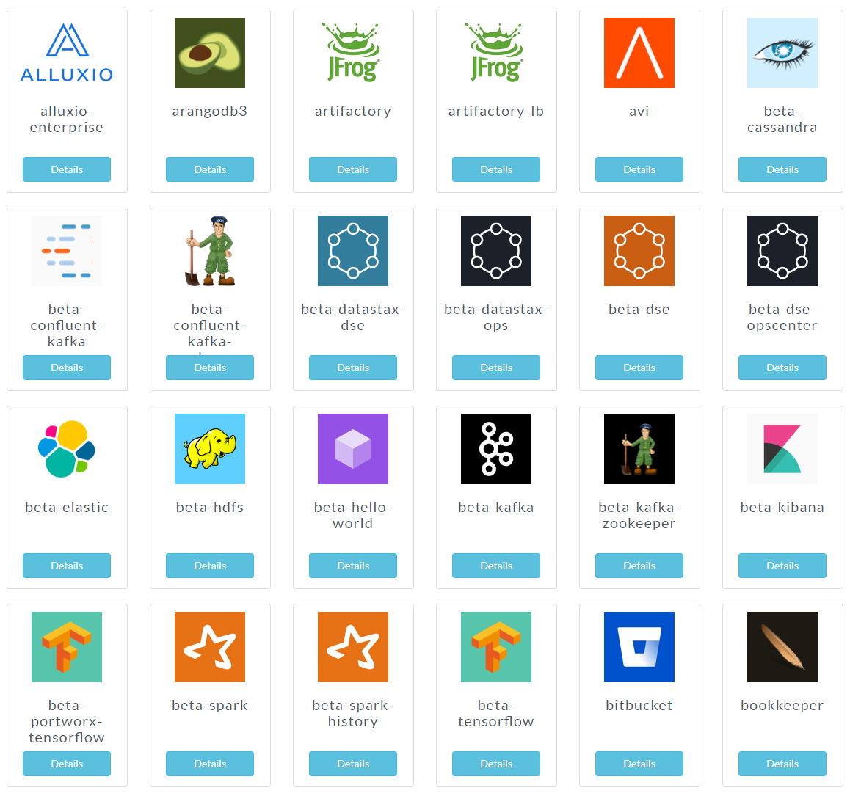
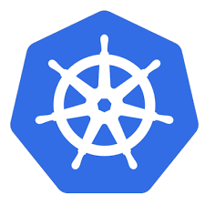



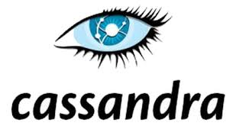


https://universe.dcos.io/
Top Workloads

Slide 12
Mesosphere DC/OS enables digital transformation
MICROSERVICES, CONTAINERS, & DEV TOOLS
DATA SERVICES, MACHINE LEARNING, & AI
1
Broad workload coverage
Run today & tomorrow’s applications including traditional J2EE, containers, analytics & ML
20+ MORE
100+ MORE
2
Application-aware automation
Automate workload-specific operating procedures to “as-a-Service” anything from Kubernetes to data services
Application-Aware Automation
Security & Compliance
Hybrid Cloud Management
Multitenancy
Datacenter and Cloud as a Single Computing Resource Powered by Apache Mesos
PHYSICAL INFRASTRUCTURE
VIRTUAL MACHINES
PUBLIC CLOUDS
Edge
Datacenter

Slide 13
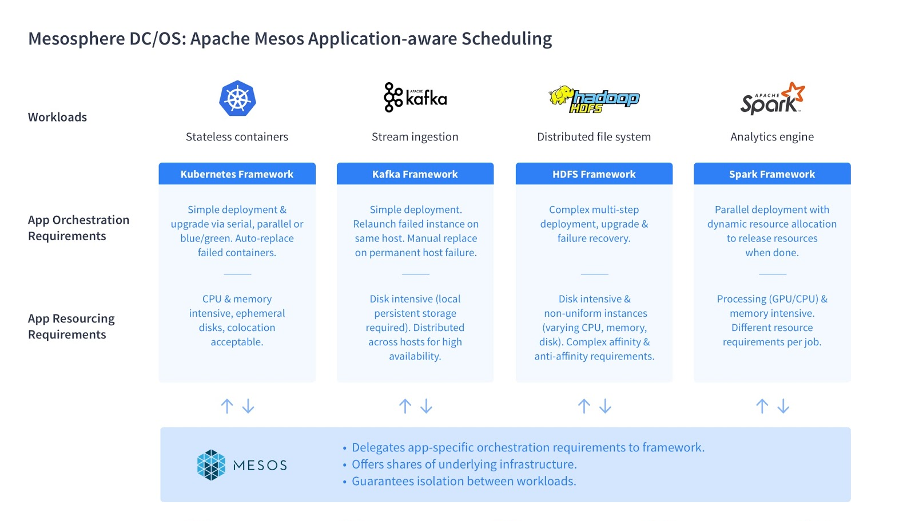

Slide 14
Mesosphere DC/OS enables digital transformation
MICROSERVICES, CONTAINERS, & DEV TOOLS
DATA SERVICES, MACHINE LEARNING, & AI
1
Broad workload coverage
Run today & tomorrow’s applications including traditional J2EE, containers, analytics & ML
20+ MORE
100+ MORE
2
Application-aware automation
Automate workload-specific operating procedures to “as-a-Service” anything from Kubernetes to data services
Application-Aware Automation
Security & Compliance
Hybrid Cloud Management
Multitenancy
3
Intelligent resource pooling
Optimize workload density for highest utilization with resource guarantees
Datacenter and Cloud as a Single Computing Resource Powered by Apache Mesos
PHYSICAL INFRASTRUCTURE
VIRTUAL MACHINES
PUBLIC CLOUDS
Edge
Datacenter

Slide 15




Workload Consolidation - Kubernetes and Data Services
Traditional Approach
Mesosphere Approach
Cluster: DevA
Kafka Cluster:
Cluster: Dev
Cluster: Prod
Somebody else’s problem?
Spark Cluster
Cluster: ProdB
OS
OS
OS
OS
OS
OS
VM
VM
VM
VM
VM
VM
Hypervisor
Hypervisor
Hypervisor
OS
OS
OS
HW
HW
HW
HW or VM
HW or VM
HW or VM
Virtualization required
High-density pooling without virtualization
Virtualization & guest operating system cost & infrastructure overhead
Secure resource isolation

Slide 16
Mesosphere DC/OS enables digital transformation
MICROSERVICES, CONTAINERS, & DEV TOOLS
DATA SERVICES, MACHINE LEARNING, & AI
1
Broad workload coverage
Run today & tomorrow’s applications including traditional J2EE, containers, analytics & ML
20+ MORE
100+ MORE
2
Application-aware automation
Automate workload-specific operating procedures to “as-a-Service” anything from Kubernetes to data services
Application-Aware Automation
Security & Compliance
Hybrid Cloud Management
Multitenancy
3
Intelligent resource pooling
Optimize workload density for highest utilization with resource guarantees
Datacenter and Cloud as a Single Computing Resource Powered by Apache Mesos
PHYSICAL INFRASTRUCTURE
VIRTUAL MACHINES
PUBLIC CLOUDS
4
Unified multi-cloud operations
Securely manage cloud, datacenter, and edge infrastructures from a single control plane
Edge
Datacenter

Slide 17
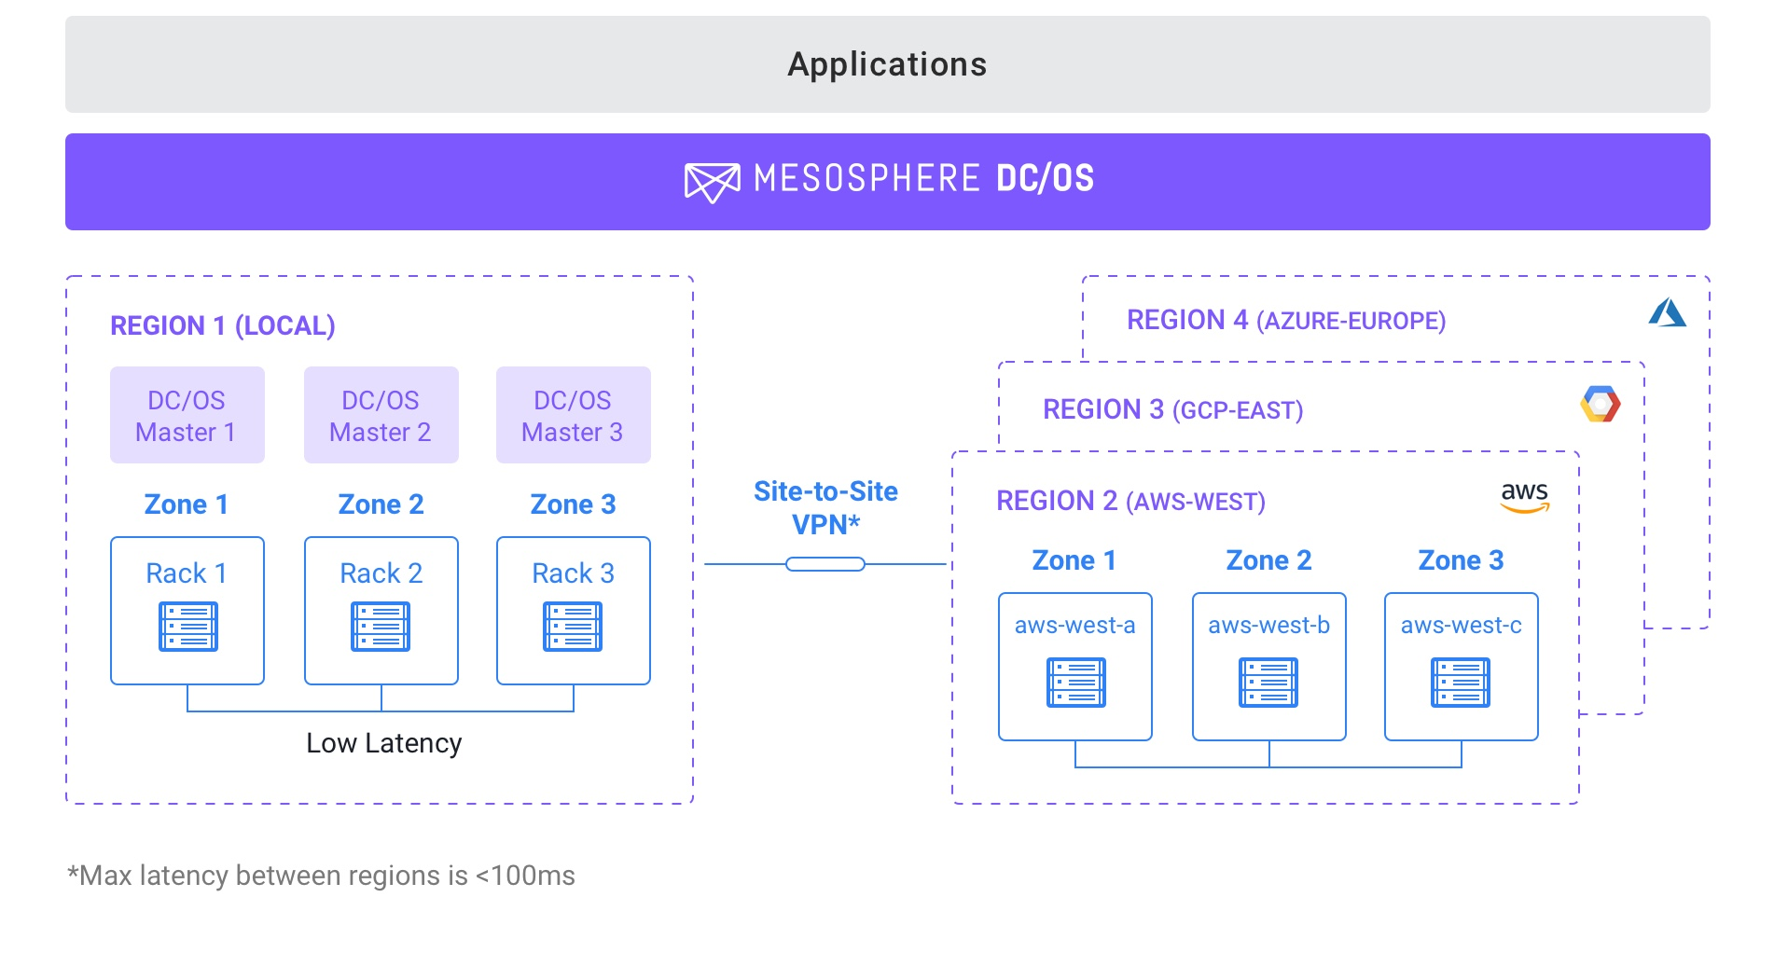
Business Continuity & Disaster Recovery: High Availability Against Datacenter or Cloud Outages
Easily deploy workloads to multiple regions (e.g., to AWS, and also on Azure), to facilitate multi-cloud high availability
Intelligently define fault domains to recover against this hierarchy to maximize service survivability
Example: Within a region, stateless services recover automatically from failures at the node, cluster, rack, or even site level

Slide 18
Mesosphere DC/OS enables digital transformation
MICROSERVICES, CONTAINERS, & DEV TOOLS
DATA SERVICES, MACHINE LEARNING, & AI
1
Broad workload coverage
Run today & tomorrow’s applications including traditional J2EE, containers, analytics & ML
20+ MORE
100+ MORE
2
Application-aware automation
Automate workload-specific operating procedures to “as-a-Service” anything from Kubernetes to data services
Application-Aware Automation
Security & Compliance
Hybrid Cloud Management
Multitenancy
3
Intelligent resource pooling
Optimize workload density for highest utilization with resource guarantees
Datacenter and Cloud as a Single Computing Resource Powered by Apache Mesos
PHYSICAL INFRASTRUCTURE
VIRTUAL MACHINES
PUBLIC CLOUDS
4
Unified multi-cloud operations
Securely manage cloud, datacenter, and edge infrastructures from a single control plane
Edge
Datacenter

Slide 19


Slide 20
Use Cases

Slide 21

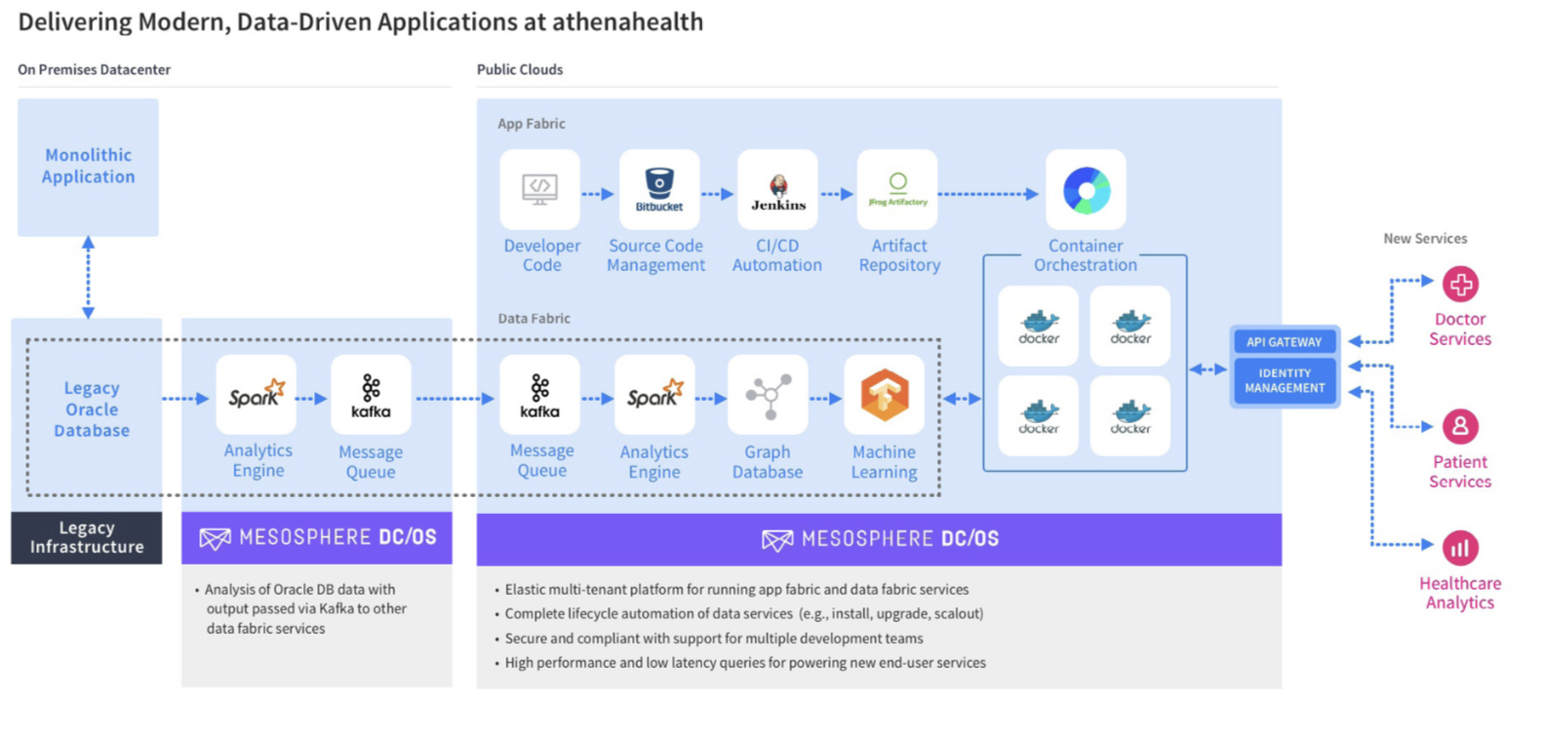

Slide 22

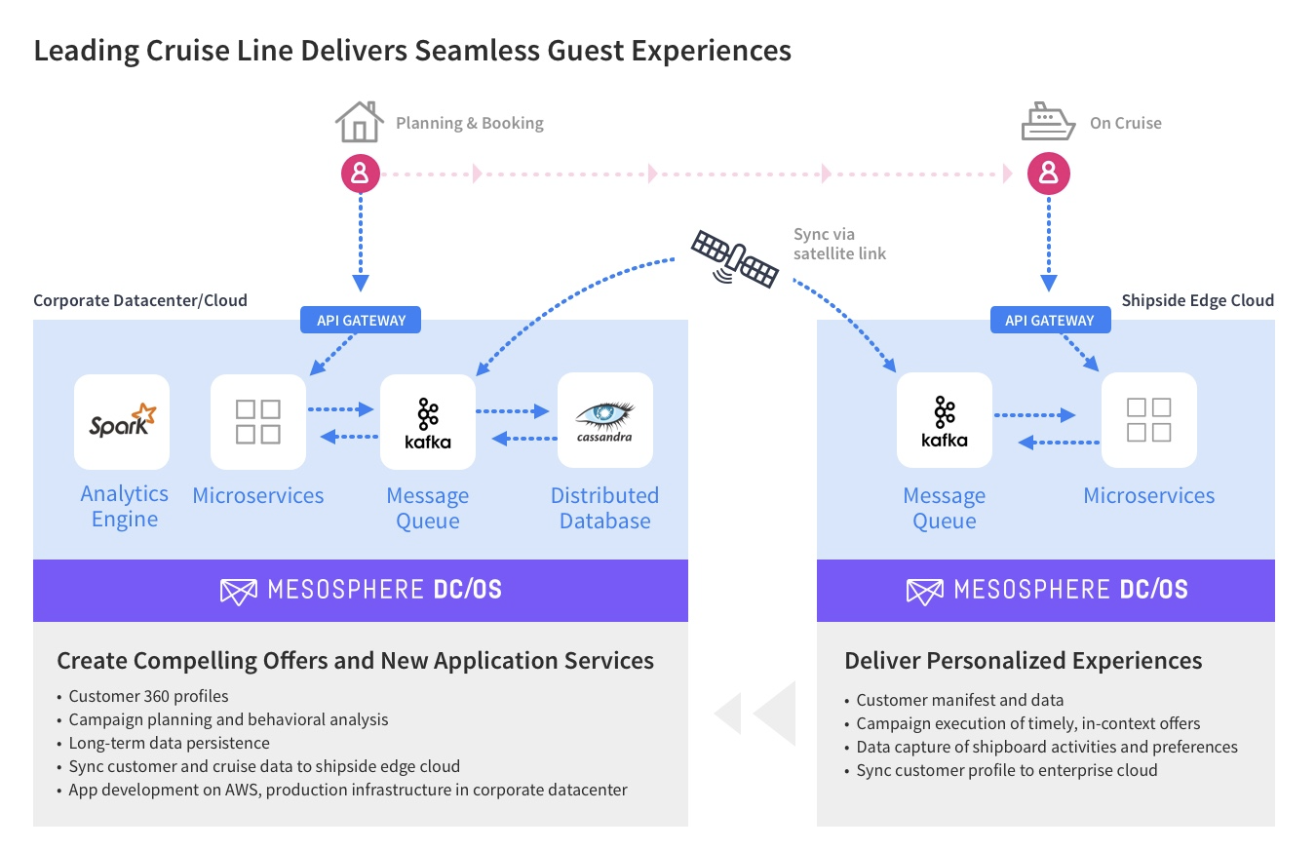

Slide 23
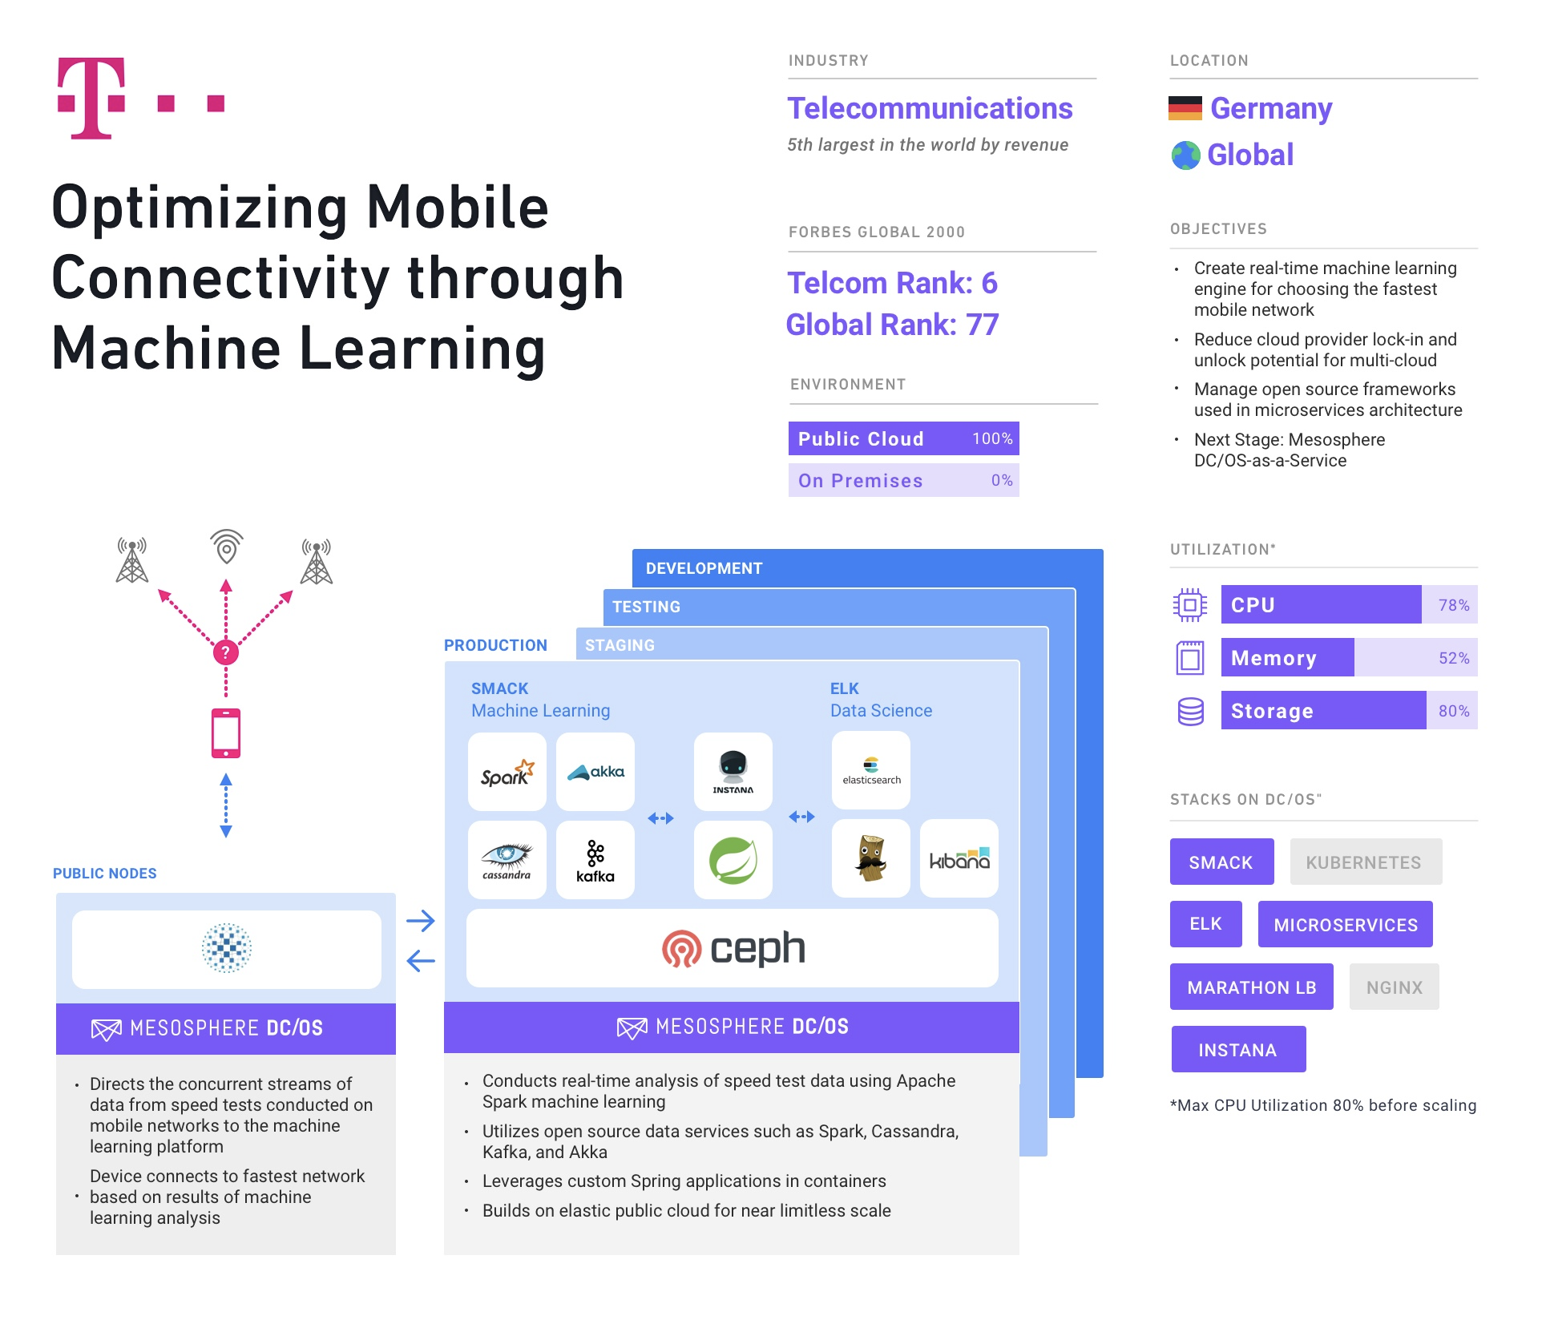

Slide 24
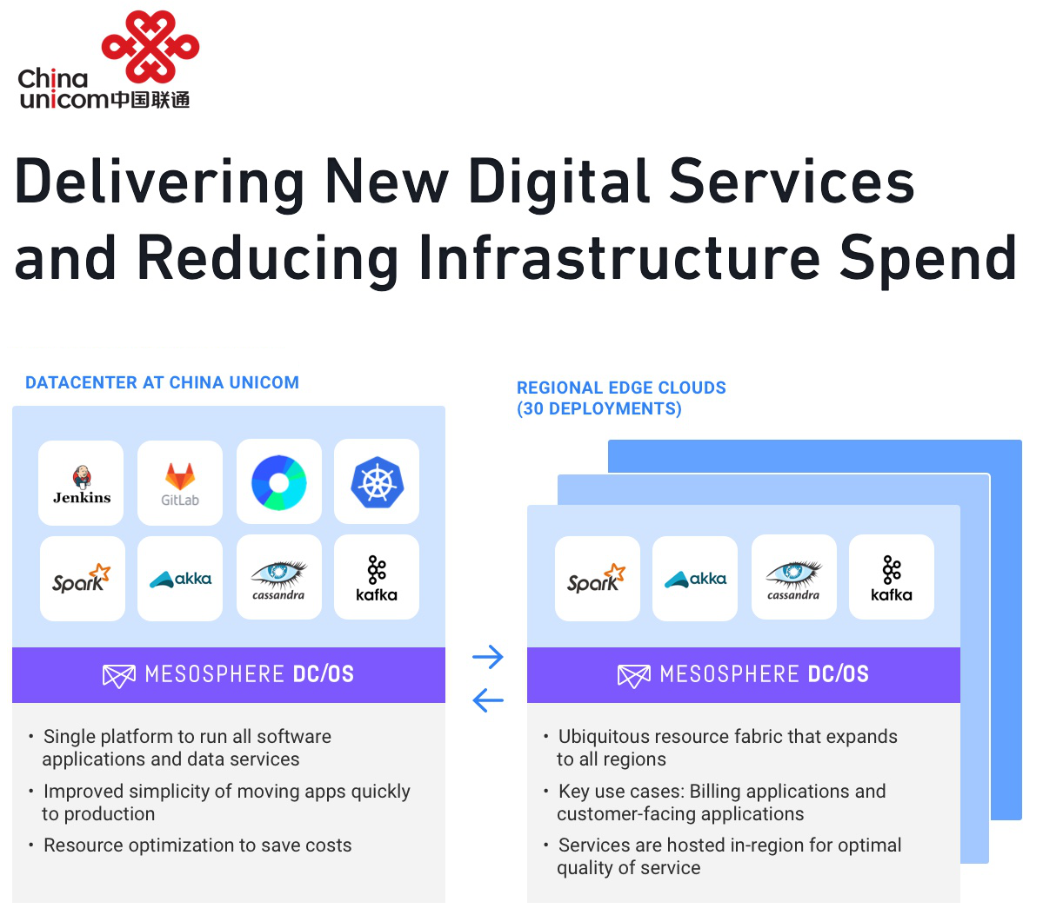
24

Slide 25
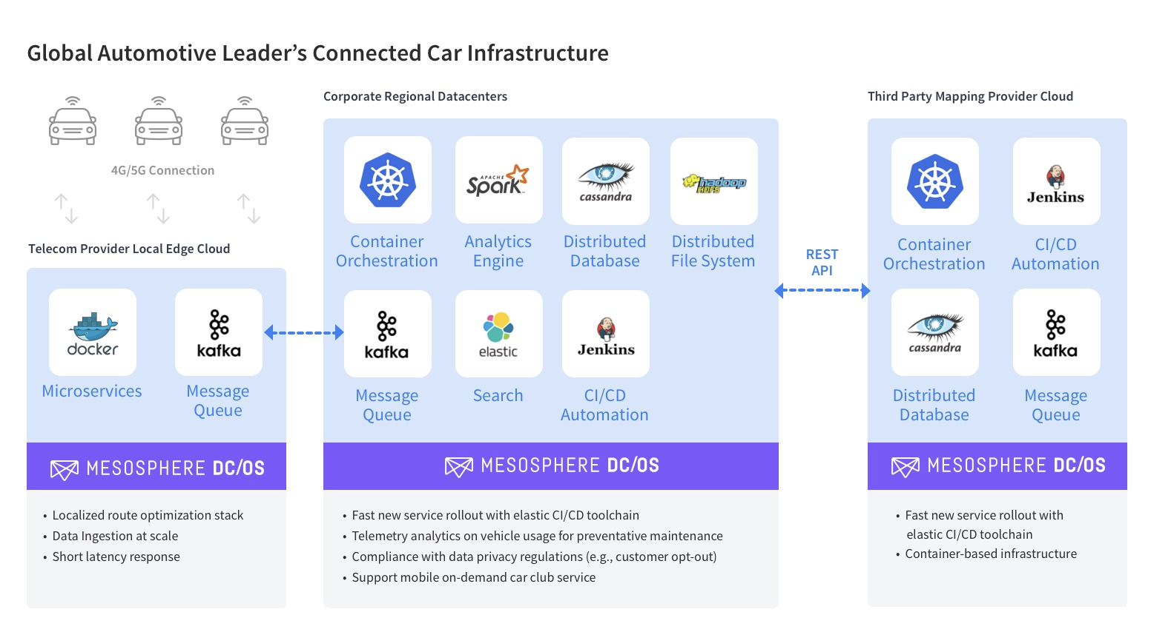

Slide 26
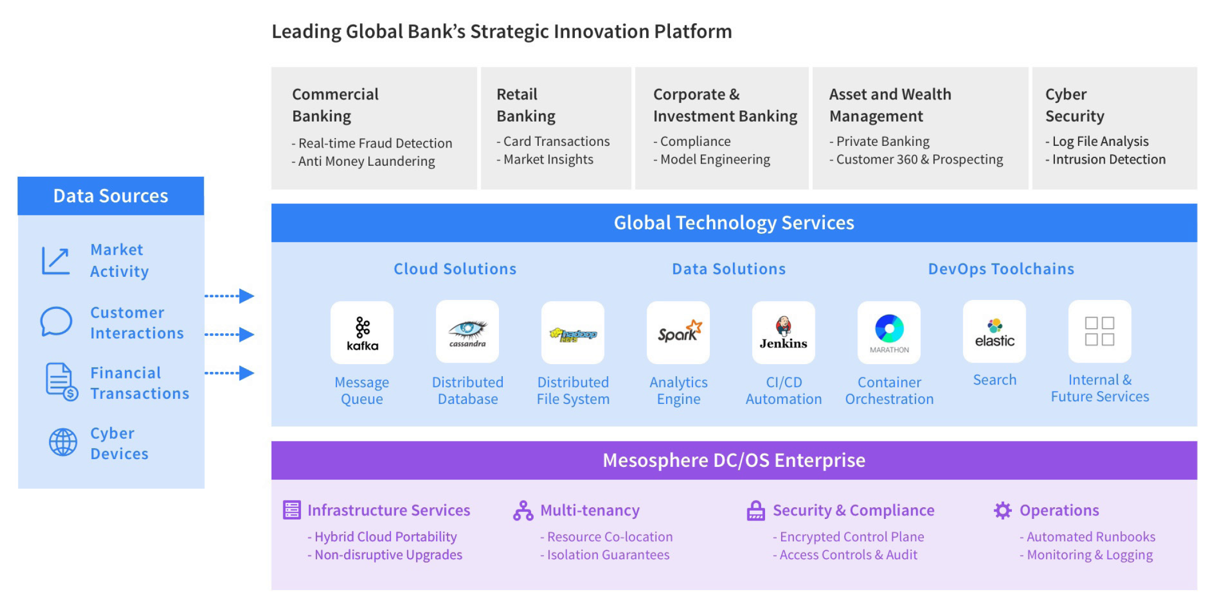


Slide 27
Appendix

